Slide 1



LEAD Others
Interpersonal
Excellence
Communication

Slide 2
LEAD Others
LEAD OTHERS - INTERPERSONAL EXCELLENCE
 | Pre-workshop study | Objectives
Communication | Identify your communication style | To identify your communication style to improve how you communicate with others
 | 3 routes to good communication | To explore the 3 routes to good communication
 | The three pillars of interpersonal excellence | To discover the 3 pillars of interpersonal excellence and enjoy successful relationships with others
 | Emotional intelligence fundamentals | To understand emotionally intelligence fundamentals
 | How to get people on your side | Make others want to understand and communicate with you
Notes:
Need to check review these.

Slide 3
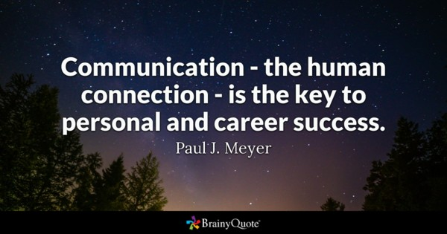
LEAD Others – Communication Styles
Good communication skills requires a high level of self-awareness. Understanding your own personal style will go a long way towards helping you to create good and lasting impressions on others. By becoming more aware of how other people perceive you, you can adapt more readily to their styles of communicating. Remaining aware of your communication style and fine-tuning it as time goes by gives you the best chance of success in business and life.
Notes:
Need to check review these.

Slide 4
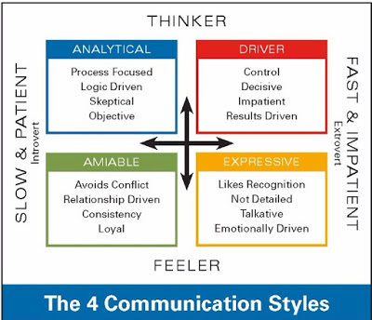
LEAD Others – Communication Styles
Complete Activity 1 – Communication Styles Self Assessment
What is Your Style?
Consider each of the questions separately and circle the one letter (a, b, c, or d) that corresponds to the description that best fits you. If you have trouble selecting only one answer, ask yourself which response, at work, would be the most natural or likely for you to make.
To consider:
How your communication style fit with your Myers Brigg profile?
Each communication type has strengths and weaknesses. Consider how to watch for these in yourselves and others you work with.
Consider how you might adjust your communication style to communicate effectively with others with different styles.
Notes:
Need to check review these.

Slide 5



LEAD Others – 3 routes to good communication
Improve non-verbal communication
Express yourself openly
Listen effectively
Notes:
Need to check review these.

Slide 6
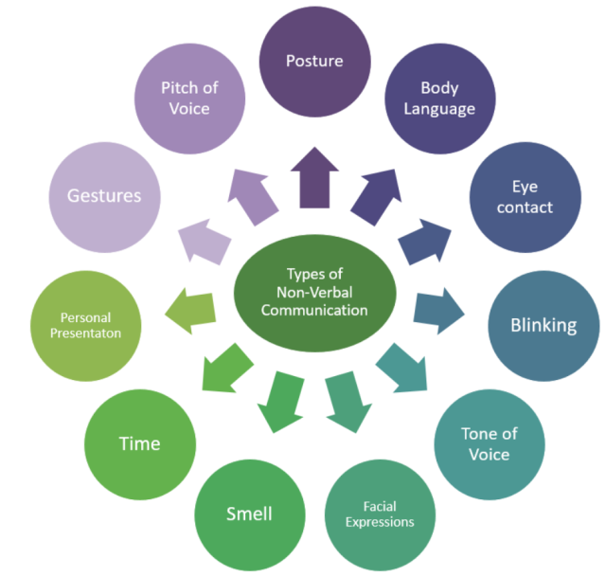
‘Actions speak louder than words’
Only 7% of personal communication is made up of your spoken words.
38% is voice and tone.
55% is body language *
Tips on improving non-verbal communication
Establish eye contact
Face people
Smile
Match other people
Concentrate on the tone of your voice
Pay attention
* Dr. Albert Mehrabian’s 7, 38, 55% Rule

Slide 7
Create open communication
Creating an atmosphere of open communication contributes to a more vibrant, creative workforce where all employees have a deep understanding of the goals of the business and what needs to be done to accomplish those goals. Open communication gives everyone equal participation in the success of the business.
Start with commitment from the top. Be visible and available to employees. Ensure that processes are in place to allow for vital information to be communicated regularly.
Keep your message positive. State messages in terms of what needs to be done and what is going well.
Make your communication process transparent. Hold meetings that give team members the opportunity to share concerns, accomplishments and ideas. Set clear expectations for all work tasks and what you expect employee behaviour to be.

Slide 8
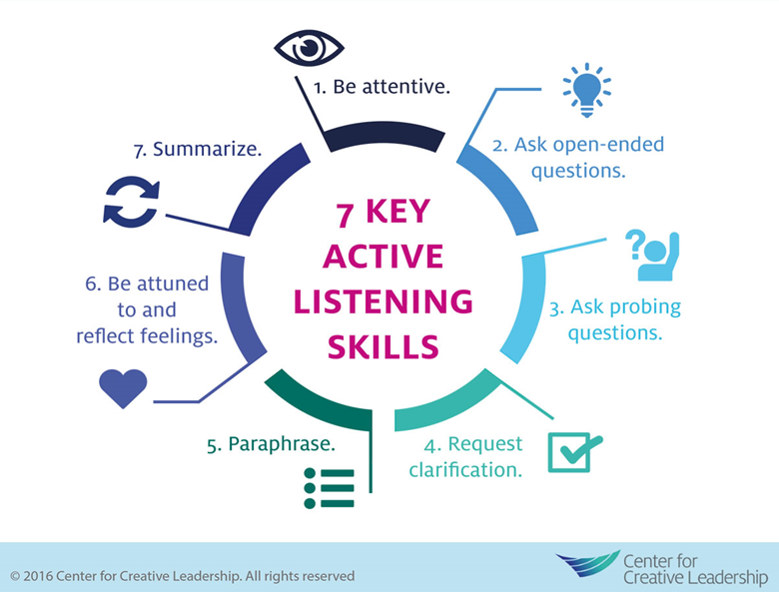
Hear what people are really saying
Listening is one of the most important skills you can have. How well you listen has a major impact on your job effectiveness, and on the quality of your relationships with others.
By becoming a better listener, you can improve your productivity, as well as your ability to influence, persuade and negotiate. What's more, you'll avoid conflict and misunderstandings.
However research suggests that we only remember between 25 percent and 50 percent of what we hear.
There are five key techniques you can use to develop your active listening skills:
Pay attention
Show that you're listening
Provide feedback
Defer judgment
Respond appropriately

Slide 9

LEAD Others – 3 pillars of Interpersonal Excellence
Have a networking strategy
Engage your personal qualities
Develop effective relationships
Notes:
Need to check review these.

Slide 10
Developing your Networking Strategy
When networking have very specific goals
Every time your meet someone new, think of one person in your network who they would benefit from knowing, then do your best to make that introduction within a week.
Ask questions about your new contacts background and work. Use alternatives to “What do you do?” for example
“What are you most excited about at the moment?”
“Any big challenges coming down the line for you?”
“What’s the next big thing coming up?”
Notes:
Need to check review these.

Slide 11
Engage your personal qualities
Become a leader whom people actually follow--not because they have to, but because you're inspiring them to greatness. Measure yourself against these attributes and ask yourself how you can lead from the very best qualities.
1. Authentic | 11. Listening
2. Brave | 12. Motivating
3. Character-driven | 13. Optimistic
4. Decision | 14. Progressive
5. Engaging | 15. Reliable
6. Fearless | 16. Supportive
7. Goal-orientated | 17. Trustworthy
8. Humble | 18. Unbiased
9. Inspiring | 19. Visionary
10. Knowledgeable | 20. Wise
Notes:
Need to check review these.

Slide 12
Develop effective working relationships
Lets look at how you can build strong, positive relationships at work, why its important to have good working relationships, and how to strengthen your relationships with people.
Why?
Human beings are naturally social creatures – we crave friendship and positive interactions. So it makes sense that the better our relationships are at work, the happier and more productive we're going to be. Good working relationships make our work more enjoyable also people are more likely to go along with changes that we want to implement, and we're more innovative and creative. Good relationships give us freedom: instead of spending time and energy overcoming the problems associated with negative relationships, we can, instead, focus on opportunities.
Notes:
Need to check review these.

Slide 13
Develop effective working relationships
How?
Develop your people skills
Identify your relationship needs
Schedule time to build relationships
Focus on your emotional intelligence
Appreciate others
Be positive
Listen actively
Notes:
Need to check review these.

Slide 14
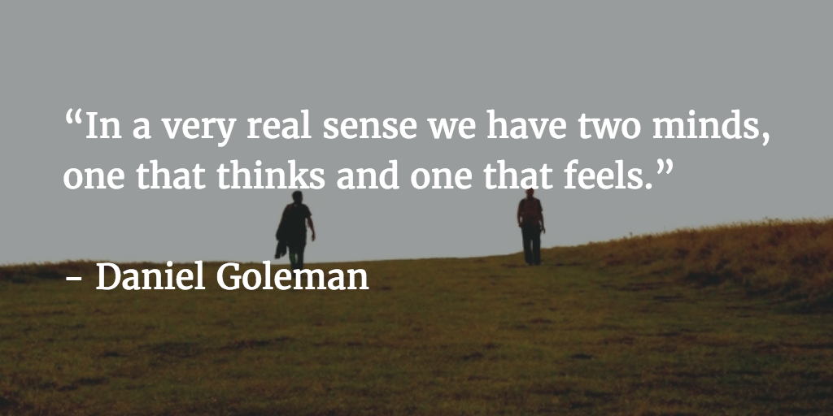
LEAD Others – Fundamentals of Emotional Intelligence
Goleman explains how two separate minds live in our brains, one rational and one emotional, and why the five key skills making up your emotional “literacy” are actually a much bigger predictor of happiness and success than the capacity by which we usually measure it: IQ.
Notes:
Need to check review these.

Slide 15
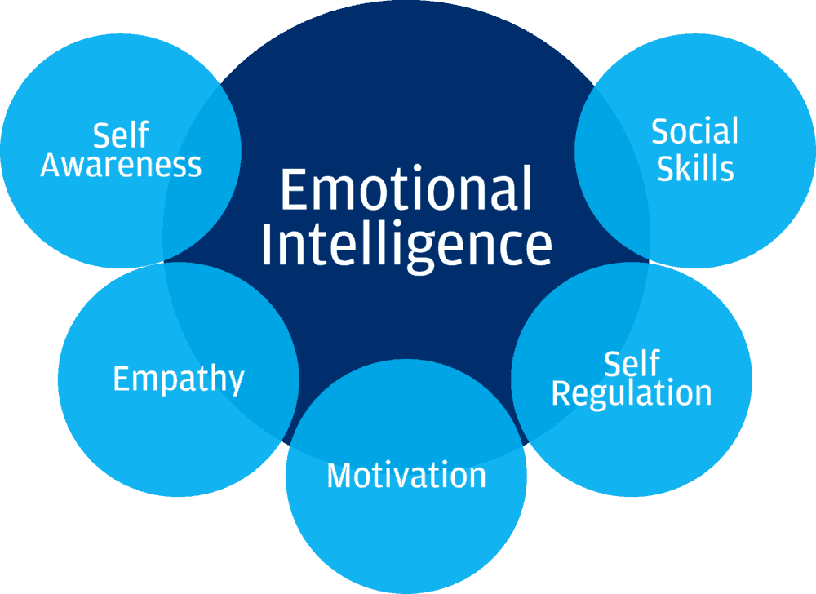
3 reasons why emotional intelligence is important and how
you can get more of it
EI rests on self-awareness and self-regulation.
High EQ makes you more successful.
You can boost EQ by mirroring other people’s body language and thinking optimistically.
Complete Activity 2: ‘How Emotionally Intelligent Am I? Questionnaire
Notes:
Need to check review these.

Slide 16
LEAD Others –Emotional Intelligence
Emotional intelligence rests on self-awareness and self-regulation.
Being emotionally self-aware means that you’re able to recognize and label your feelings. Emotional self-regulation is being able to look at your emotions and choosing how to react to your feelings – or if you should react at all.
If you have a high EQ, you’re more likely to be successful
IQ, the level of your intelligence, is usually what we think determines success. But Goleman’s research led him to believe that EQ, emotional intelligence, is just as, if not more important, to find happiness.
Managers, who are socially skilled, will have the power to persuade people when they need to and thus do a better job at leading people.
Notes:
Need to check review these.

Slide 17
LEAD Others –Emotional Intelligence
3. You can boost your EQ by mirroring other people’s body language and thinking optimistically.
Mirroring other people’s body language will not only help you connect better with the person across the table, it’ll also make you more emotionally self-aware. For example, when the person you talk to has great posture, straightening your own body will send subtle non-verbal cues to them, that they can trust you.
Optimistic people continue to try, because they believe their actions make a difference, and are thus more likely to succeed. This is based on how they explain failures. They think bad events are temporary, external and specific, and that they have the power to change them for the better by improving the next time.
Notes:
Need to check review these.

Slide 18
LEAD Others – Getting your message across
Gravitas is the difference that makes all the difference when it comes to communication. It gives you the influence and authority. You will be confident to be yourself and have the power to command the trust and respect of others.
Gravitas n. figuratively of persons, ‘dignity, presence, influence’
Knowledge
(Logos)
Your zone of expertise. Ideas, words, reasoning, how you think and how you express
Purpose
(Ethos)
Your values, goals and character
Passion
(Pathos)
Your feelings and emotions. The spark that sets your ideas and knowledge alight.

Slide 19
Getting the right style for the occasion
A pilot of a plane needs to you make you feel you are in safe hands. They use a calm, low, resonant voice which gives you a feeling of safety and security. The pilot is able to balance their creditability – their status as an expert – and the care and connection they have with passengers. A friendly air stewardess on the other hand builds a connection by being friendly and accommodating.
You can change gear between status (pilot of the plane) and connection (friendly air stewardess)
STATUS GRAVITAS CONNECTION
Notes:
Need to check review these.

Slide 20
Getting the right style for the occasion
Complete Activity 3 – Status or Connection? We can all do both but sometimes get stuck in one style.
 | STATUS | CONNECTION
Values | Respect | Friendship
Decision Style | Makes own mind up | Asks advice
Style | Authority | Empathy
Focus | Task | Relationship
Speaking style | Report-talk (sounds authoritative) | Rapport-talk (sounds approachable)
In a team | Competitive | Collaborative
Notes:
Need to check review these.

Slide 21
LEAD Others – Interpersonal Excellence Further learning resources
4 communication styles
Build don't break relationships with communication - connect the dots | Amy Scott | TEDxQueenstown
3 Tips for Effective Active Listening (2.04 mins)
The power of listening | William Ury | TEDxSanDiego (15.40 mins)
Daniel Goleman Introduces Emotional Intelligence (5.31 mins)
6 Steps to Improve Your Emotional Intelligence | Ramona Hacker | TEDxTUM (17 mins)
Gravitas – Caroline Goy (2.54 mins)
Notes:
Need to check review these.

Slide 22
LEAD Others – Interpersonal Excellence Key learning points and Next Steps
Self-awareness of your own communication style will help you understand how others might perceive you and adapt more readily to the communication styles of others.
Effective communication is not just about what you say, but how effective you are in using non-verbal communication skills, how open you are and your listening skills.
You can develop your interpersonal excellence through the development of networks, effective working relationships and your own personal qualities.
If you are in tune with your own emotional intelligence you will be better at reading emotions in others.
Having knowledge, a clear purpose and passion in what you communicate will give you influence and authority.
Notes:
Need to check review these.

